Slide 1


Development of a Nanofibre-Based Drug Delivery Framework of Thymoquinone for Transdermal Application in Localised Breast Tumour Therapy
Royal Pharmaceutical Society (RPS) Annual Conference, London (7th Nov. 2025)
Ghazali, Y.¹, Conway, B.¹, Adebisi, A.¹
¹ Department of Pharmacy, School of Applied Science, University of Huddersfield, Huddersfield, England

Slide 2
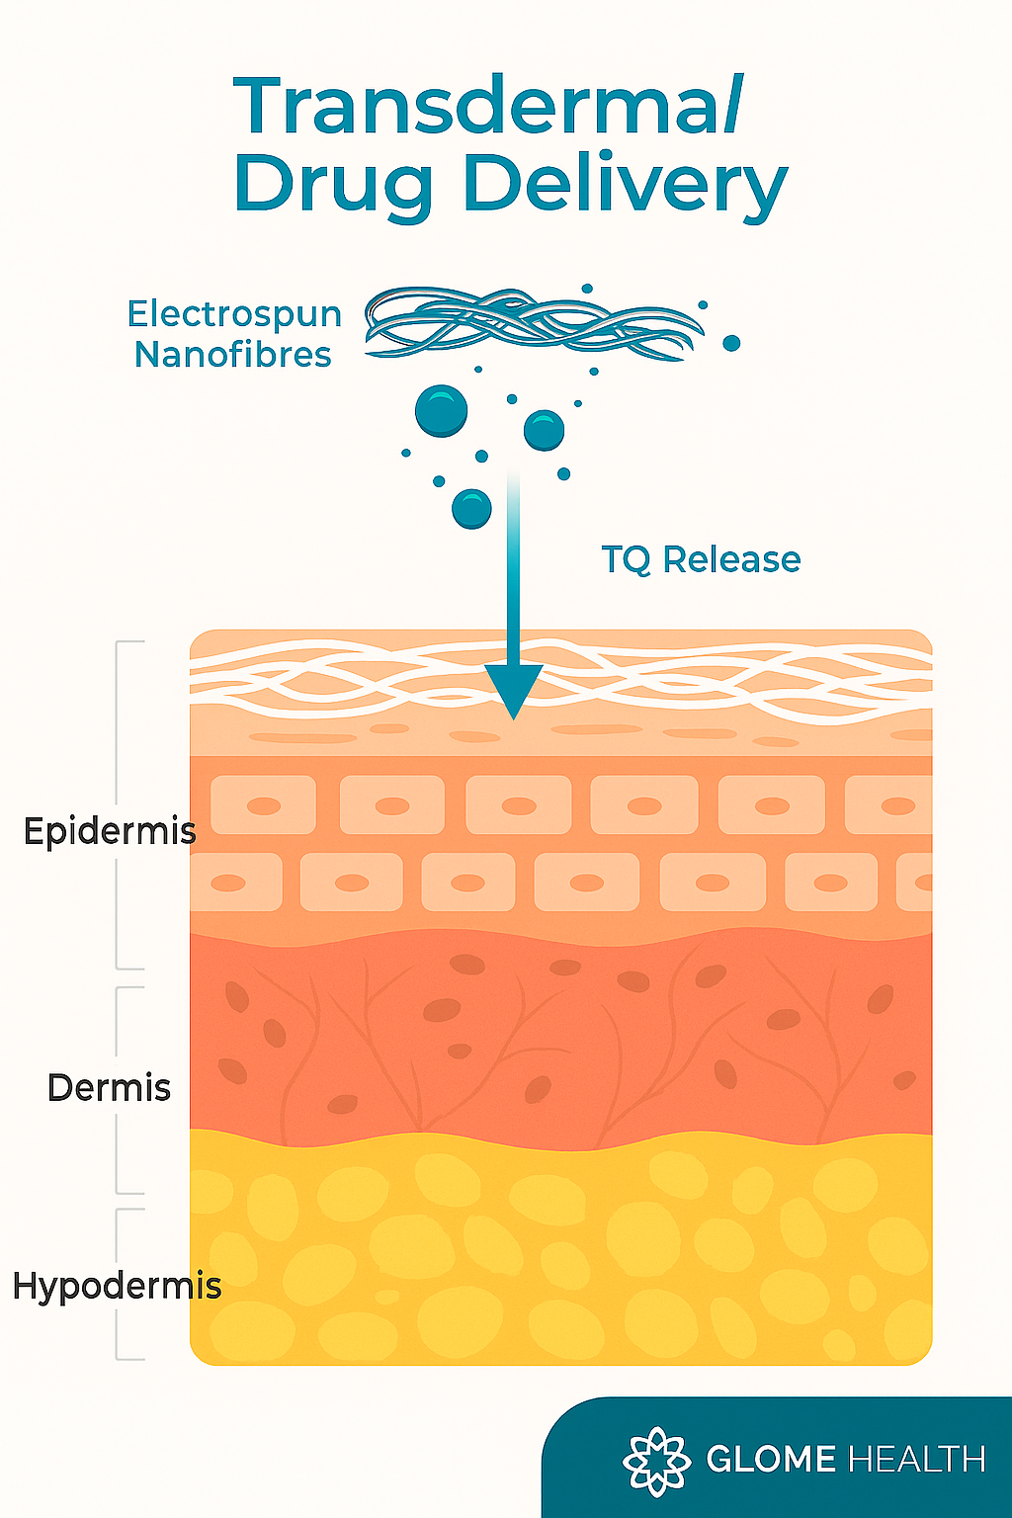
Introduction
Breast tumour remains a leading global cause of mortality [1].
Current treatments are quite invasive, with limited target precision.
Nanofibre systems, with high surface area-to-volume ratio can enable controlled and localised release [2].
In this study, we report the preliminary development of thymoquinone (TQ) ‑ loaded nanofibres, investigating their suitability as a platform for localised transdermal delivery against breast tumours.
2

Slide 3
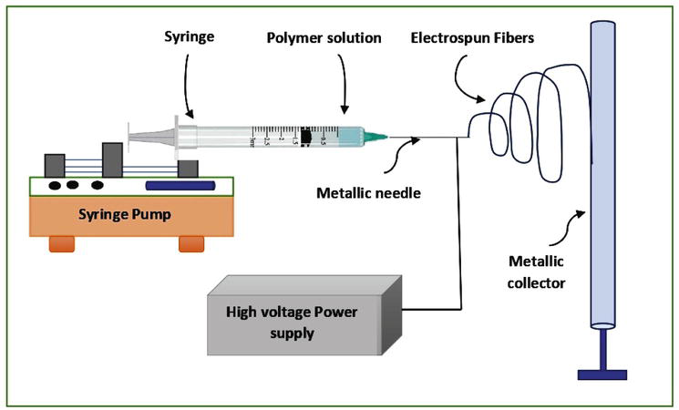
Method
Electrospinning Setup
Polyoxazoline (POX) nanofibres with TQ (1 mg/mL) fabricated using Spinbox System (Bionicia, Spain).
Design of Experiment
POX concentration (25–35 % w/v), voltage (15–20 kV), and flow rate (0.5–1.0 mL/hr) were varied across 10 trial formulations.
Fibre Characterisation
Morphology and diameter assessed via Keyence Microscope imaging and ImageJ analysis.
3

Slide 4
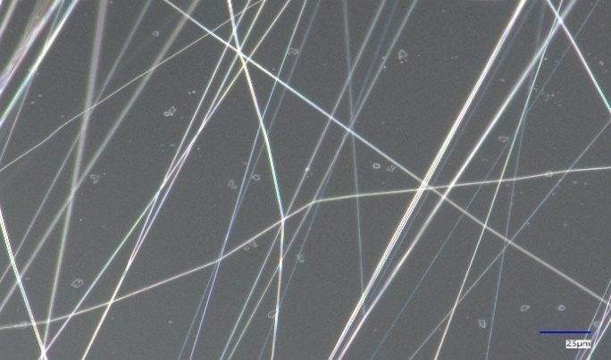
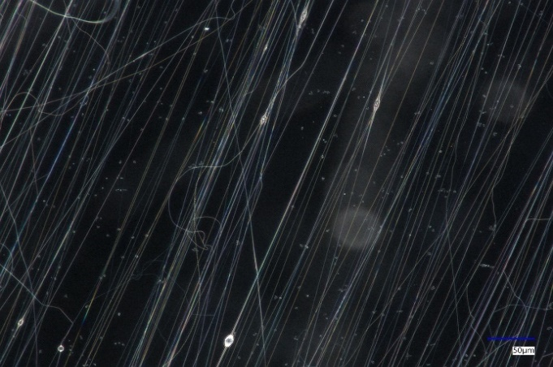
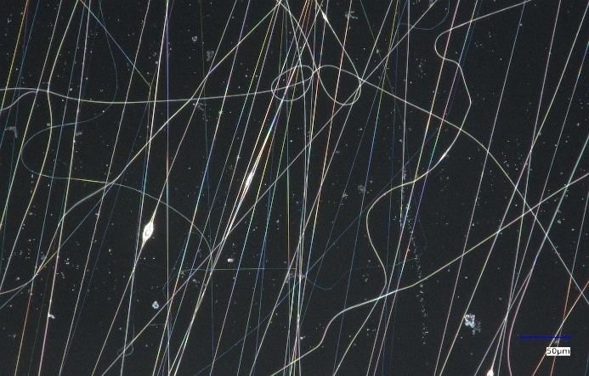
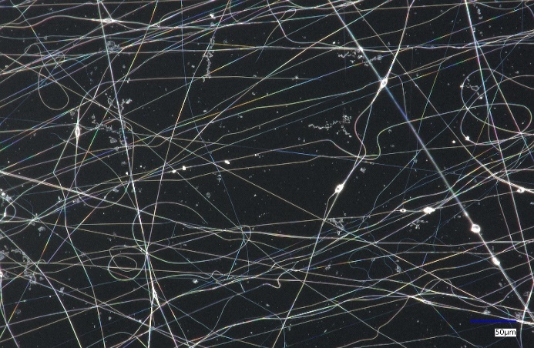
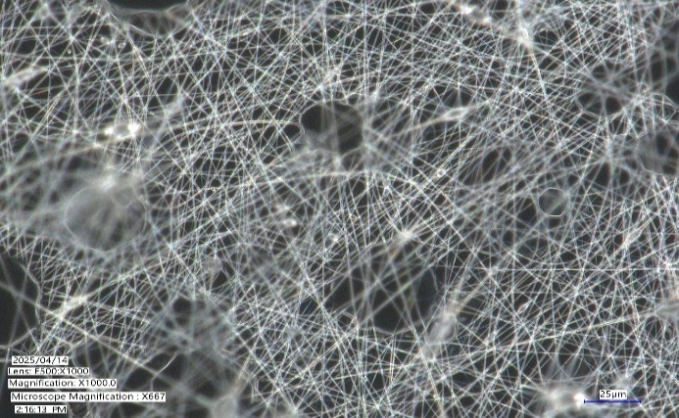
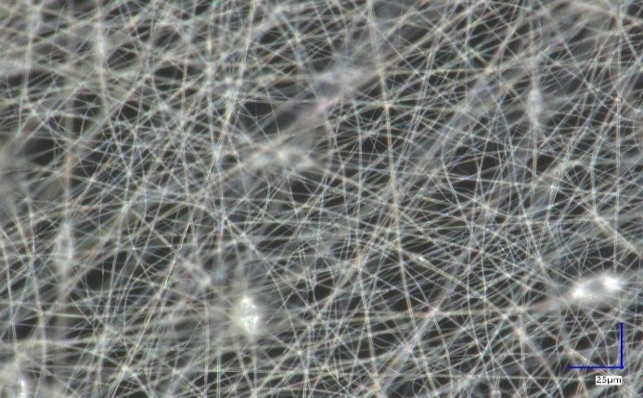
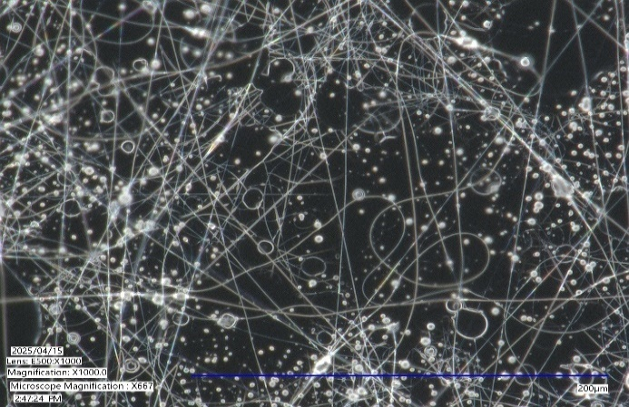
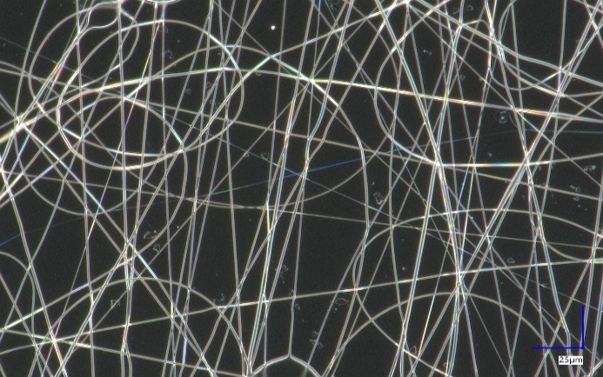
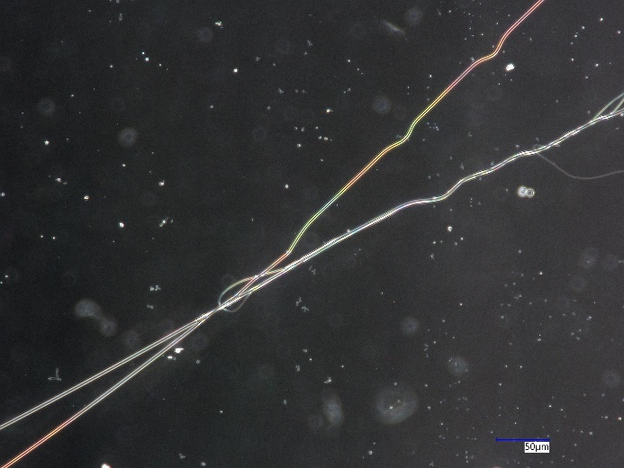
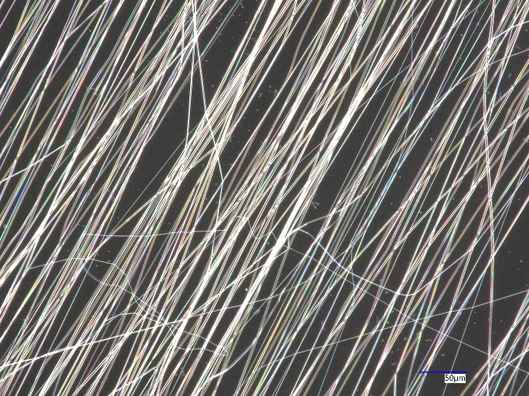
Results
F1 Nanofiber; Diameter = 0.516 ± 0.007 μm
F2 Nanofiber; Diameter = 0.450 ± 0.064 μm
F3 Nanofiber; Diameter = 0.765 ± 0.019 μm
F4 Nanofiber; Diameter = 0.506 ± 0.089 μm
F5 Nanofiber; Diameter = 0.848 ± 0.065 μm
F6 Nanofiber; Diameter = 0.731 ± 0.015 μm
F7 Nanofiber; Diameter = 1.161 ± 0.168 μm
Nanofibre Diameter Range: 0.397–1.161 μm across formulations; seven (F1–F4, F8–F10) achieved smooth, uniform fibres within the favourable 300–800 nm window for transdermal delivery.
F8 Nanofiber; Diameter = 0.466 ± 0.012 μm
F9 Nanofiber; Diameter = 0.583 ± 0.025 μm
F10 Nanofiber; Diameter = 0.397 ± 0.020 μm

Slide 5
Conclusion
“This work demonstrates the successful development of TQ-loaded POX nanofibre frameworks using electrospinning. A set of seven formulations met the criteria for diameter and morphology, with further characterisation and optimisation planned. These nanofibre frameworks hold potential as core components of transdermal systems for localised breast tumour therapy.”
References:
[1] Bray F, Ferlay J, Soerjomataram I, Siegel RL, Torre LA, Jemal A. Global cancer statistics 2018: GLOBOCAN estimates of incidence and mortality worldwide for 36 cancers in 185 countries. CA: a cancer journal for clinicians. 2018 Nov;68(6):394-424.
[2] Bhattarai DP, Aguilar LE, Park CH, Kim CS. A review on properties of natural and synthetic based electrospun fibrous materials for bone tissue engineering. Membranes. 2018;8(3):62. doi:10.3390/membranes8030062.

Slide 6

6

